Slide 1
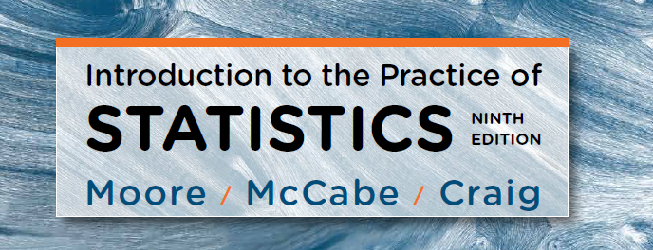
Chapter 1:
Looking at Data — Distributions
Lecture Presentation Slides
Macmillan Learning © 2017

Slide 2
Chapter 1
Looking at Data—
Distributions
Introduction
1.1 Data
1.2 Displaying Distributions with Graphs
1.3 Describing Distributions with Numbers
1.4 Density Curves and Normal Distributions

Slide 3
1.1 Data
Cases, labels, variables, and values
Categorical and quantitative variables
Key characteristics of a data set

Slide 4
Cases, Labels, Variables, and Values
Cases are the objects described by a set of data. Cases may be customers, companies, subjects in a study, units in an experiment, or other objects.
A label is a special variable used in some data sets to distinguish the different cases.
A variable is a special characteristic of a case.
Different cases can have different values of a variable.

Slide 5
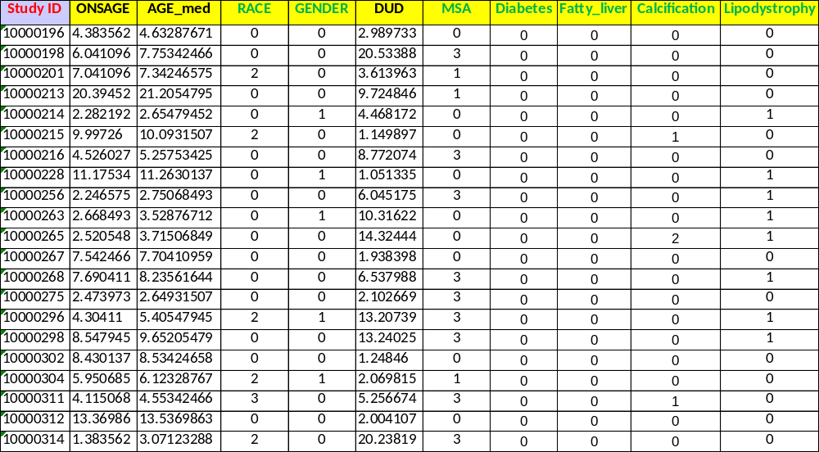
Label ? Variables? Case? Value?
MSA: myositis-specific autoantibodies
Notes:
This is a clean dataset… however, in reality, there are a lot of issues regarding raw data such as missing data, coding error, inconsistency, etc. (example data)

Slide 6
Categorical and Quantitative Variables
A categorical variable places each case into one of several groups, or categories.
A quantitative variable takes numerical values for which arithmetic operations such as adding and averaging make sense.

Slide 7
Key Characteristics of a Data Set
Every data set is accompanied by important background information. In a statistical study, always ask the following questions:
Who? What cases do the data describe? How many cases does a data set have?
What? How many variables does the data set have? What are the exact definitions of these variables? What are the units of measurement for each quantitative variable?
Why? What purpose do the data have? Do the data contain the information needed to answer the questions of interest?
Notes:
Some data may leave you only few cases for a specific study question after filtering the data (by specific criteria)

Slide 8
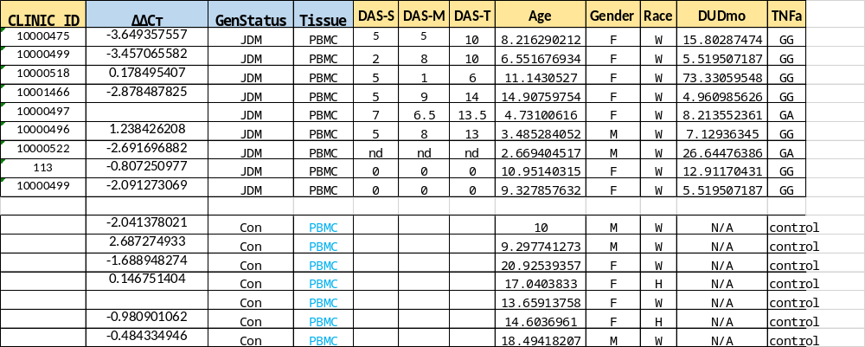
Notes:
This is messy, requiring a lot of cleaning.

Slide 9
1.2 Displaying Distributions with Graphs
Exploratory Data Analysis
Graphs for categorical variables
  Bar graphs
  Pie charts
Graphs for quantitative variables
  Histograms
  Stemplots

Slide 10
Exploratory Data Analysis
Exploring Data
  Begin by examining each variable by itself (univariate). Then move on to study the relationships among the variables.
  Begin with a graph or graphs. Then add numerical summaries of specific aspects of the data.

Slide 11
Variables
For each case in a data set, we record information about characteristics that we call variables.
Individual
An object described by data
Categorical variable
Places individual into one of several groups or categories
Variable
Characteristic of the individual
Quantitative variable
Takes numerical values for which arithmetic operations make sense

Slide 12
Categorical or quantitative variables?
MSA: myositis-specific autoantibodies
Notes:
This is a clean dataset… however, in reality, there are a lot of issues regarding raw data such as missing data, coding error, inconsistency, etc. (example data)

Slide 13
Distribution of a Variable
To examine a single variable, we graphically display its distribution.
  The distribution of a variable tells us what values it takes and how often it takes these values.
  Distributions can be displayed using a variety of graphical tools. The proper choice of graph depends on the nature of the variable.
Categorical variable
Pie chart
Bar graph
Quantitative variable
Histogram
Stemplot

Slide 14
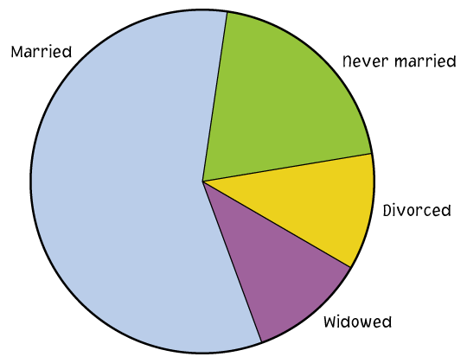
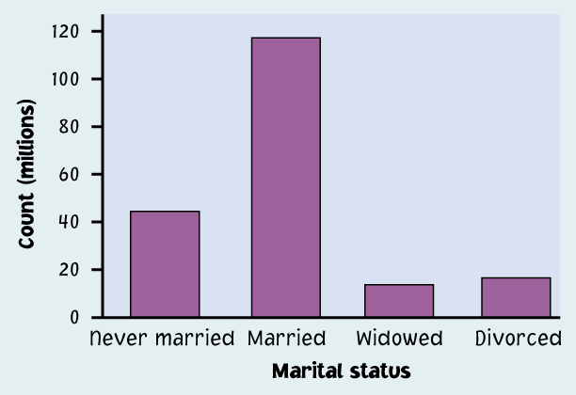
Categorical Variables
The distribution of a categorical variable lists the categories and gives the count or percent of individuals who fall into each category.
  Pie charts show the distribution of a categorical variable as a “pie” whose slices are sized by the counts or percents for the categories.
  Bar graphs represent categories as bars whose heights show the category counts or percents.

Slide 15
Pie Charts and Bar Graphs
Resource | Count | Percent of total
Google or Google Scholar | 406 | 73.6%
Library database or website | 75 | 13.6%
Wikipedia or online encyclopedia | 52 | 9.4%
Other | 19 | 3.4%
Total | 552 | 100.0%

Slide 16
Quantitative Variables
The distribution of a quantitative variable tells us what values the variable takes on and how often it takes those values.
  Stemplots separate each observation into a stem and a leaf that are then plotted to display the distribution while maintaining the original values of the variable.
  Histograms show the distribution of a quantitative variable by using bars. The height of a bar represents the number of individuals whose values fall within the corresponding class (or interval).

Slide 17
Stemplots 1
To construct a stemplot:
Separate each observation into a stem (all but the rightmost digit) and a leaf (the remaining digit).
Write the stems in a vertical column; draw a vertical line to the right of the stems.
Write each leaf in the row to the right of its stem; order leaves if desired.

Slide 18
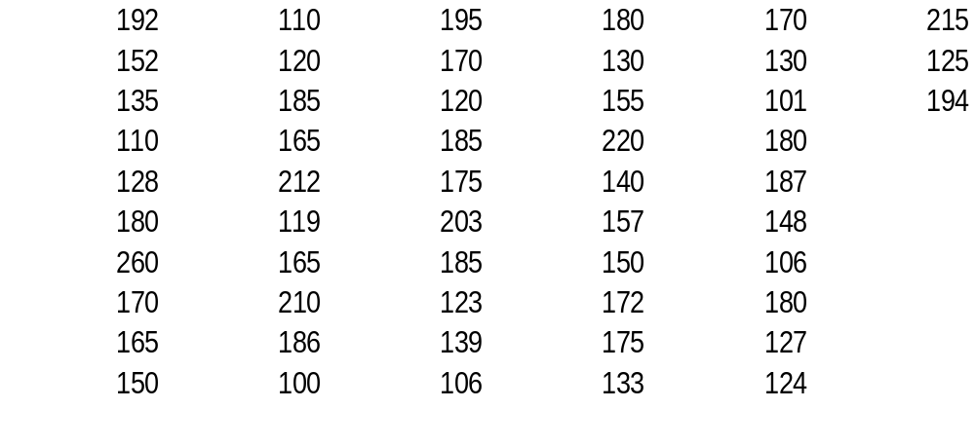
Stemplots 2
Example: Weight Data ― Introductory Statistics Class
10 0166
11 009
12 0034578
13 00359
14 08
15 00257
16 555
17 000255
18 000055567
19 245
20 3
21 025
22 0
23
24
25
26 0
5
2
2
Key
20|3 means
203 pounds
Stems = 10s
Leaves = 1s
Stems
Leaves

Slide 19
Stemplots 3
If there are very few stems (when the data cover only a very small range of values), then we may want to create more stems by splitting the original stems.
Example: If all of the data values are between 150 and 179, then we may choose to use the following stems:
15
15
16
16
17
17
Leaves 0–4 would go on each upper stem (first “15”), and leaves 5–9 would go on each lower stem (second “15”).
Notes:
ASK: Why do we do this? To see the variation

Slide 20
Histograms 1
For large datasets and/or quantitative variables that take many values:
  Divide the possible values into classes or intervals of equal widths.
  Count how many observations fall into each interval. Instead of counts, one may also use percents.
  Draw a picture representing the distribution―each bar height is equal to the number (or percent) of observations in its interval.

Slide 21
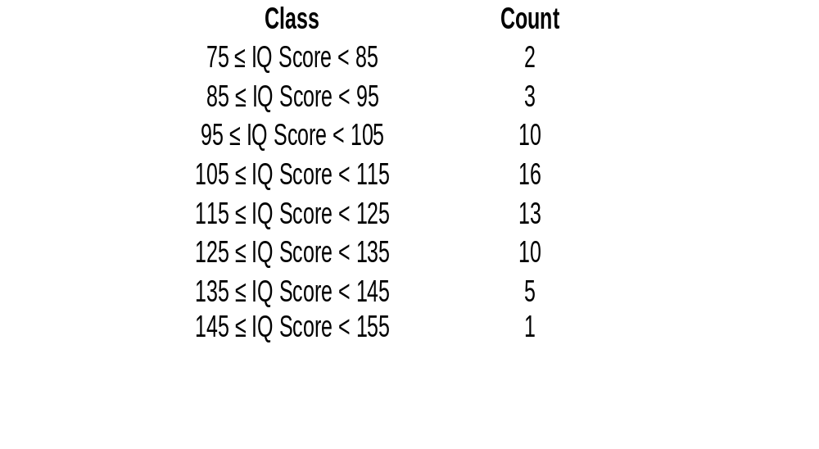
Histograms 2
Example: IQ Scores – 60 5th graders

Slide 22
Examining Distributions 1
  In any graph of data, look for the overall pattern and for striking deviations from that pattern.
  You can describe the overall pattern by its shape, center, and spread.
  An important kind of deviation is an outlier, an individual that falls outside the overall pattern.

Slide 23
Examining Distributions 2
A distribution is symmetric if the right and left sides of the graph are approximately mirror images of each other.
A distribution is skewed to the right (right-skewed) if its right tail is substantially longer than its left tail.
A distribution is skewed to the left (left-skewed) its left tail is substantially longer than its right tail.
Symmetric
Left-skewed
Right-skewed
Notes:
ASK: examples of these 3 distributions?

Slide 24
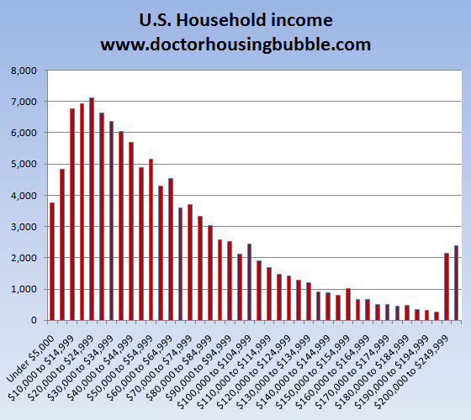
Notes:
https://www.statisticshowto.com/probability-and-statistics/skewed-distribution/

Slide 25
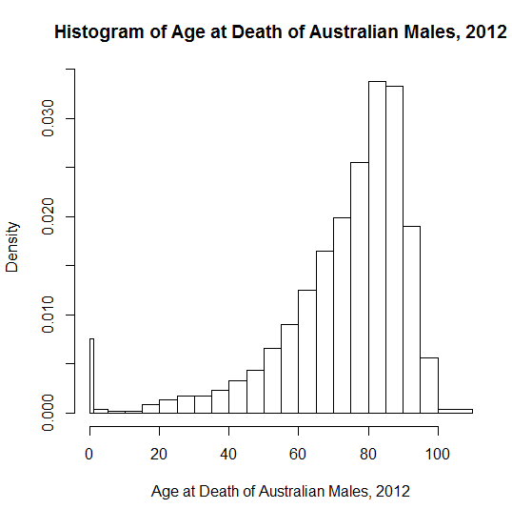
https://stats.stackexchange.com/questions/89179/real-life-examples-of-distributions-with-negative-skewness/89670
Notes:
library(HistogramTools)
deathCounts <- c(565, 116, 69, 78, 319, 501, 633, 655, 848, 1226, 1633, 2459, 3375, 4669, 6152, 7436, 9526, 12619, 12455, 7113, 2104, 241)
ageBreaks <- c(0, 1, 5, 10, 15, 20, 25, 30, 35, 40, 45, 50, 55, 60, 65, 70, 75, 80, 85, 90, 95, 100, 110)
myhist <- PreBinnedHistogram( breaks = ageBreaks, counts = deathCounts, xname = "Age at Death of Australian Males, 2012")
plot(myhist)

Slide 26
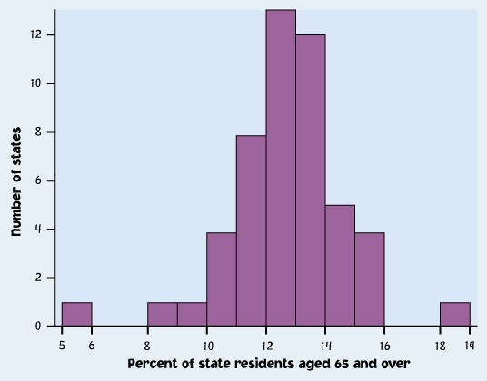
Outliers
An important kind of deviation is an outlier. Outliers are observations that lie outside the overall pattern of a distribution. Always look for outliers and try to explain them.
The overall pattern is fairly symmetrical except for two states that clearly do not belong to the main pattern. Alaska and Florida have unusually small and large percents, respectively, of elderly residents in their populations.
A large gap may indicate a possible outlier.
Alaska
Florida

Slide 27
Time Plots 1
A time plot shows behavior over time.
  Time is always on the horizontal axis, and the variable being measured is on the vertical axis.
  Look for an overall pattern (trend) and deviations from this trend. Connecting the data points by lines may emphasize this trend.
  Look for patterns that repeat at known regular intervals (seasonal variations) – COVID-19 confirmed cases
Notes:
An electrocardiogram (ECG) is one of the simplest and fastest tests used to evaluate the heart
EKG

Slide 28
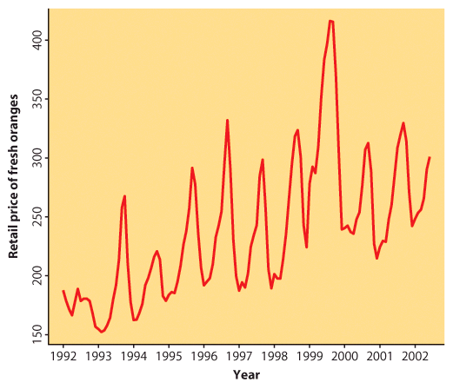
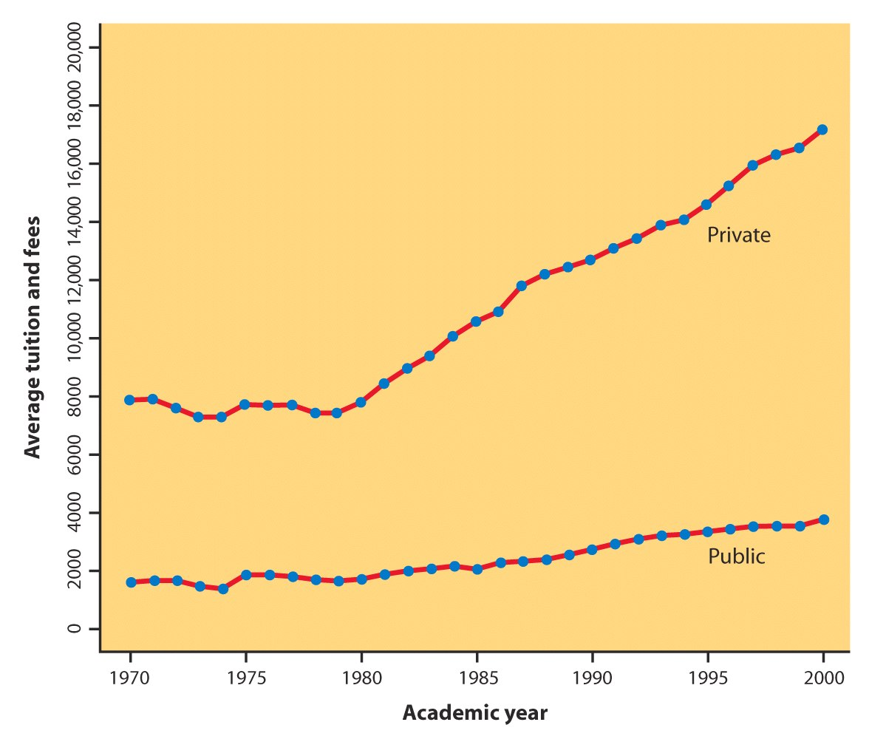
Time Plots 2
Notes:
Number of patients in the Flu season

Slide 29
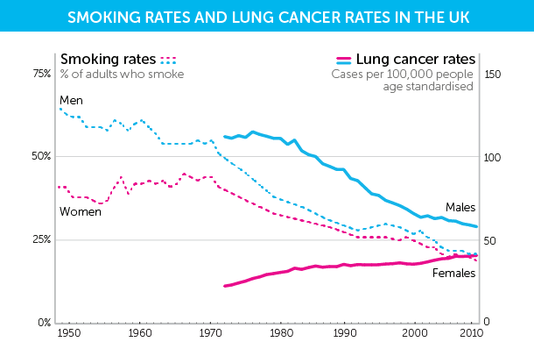
Notes:
https://scienceblog.cancerresearchuk.org/2015/02/04/why-are-cancer-rates-increasing/

Slide 30
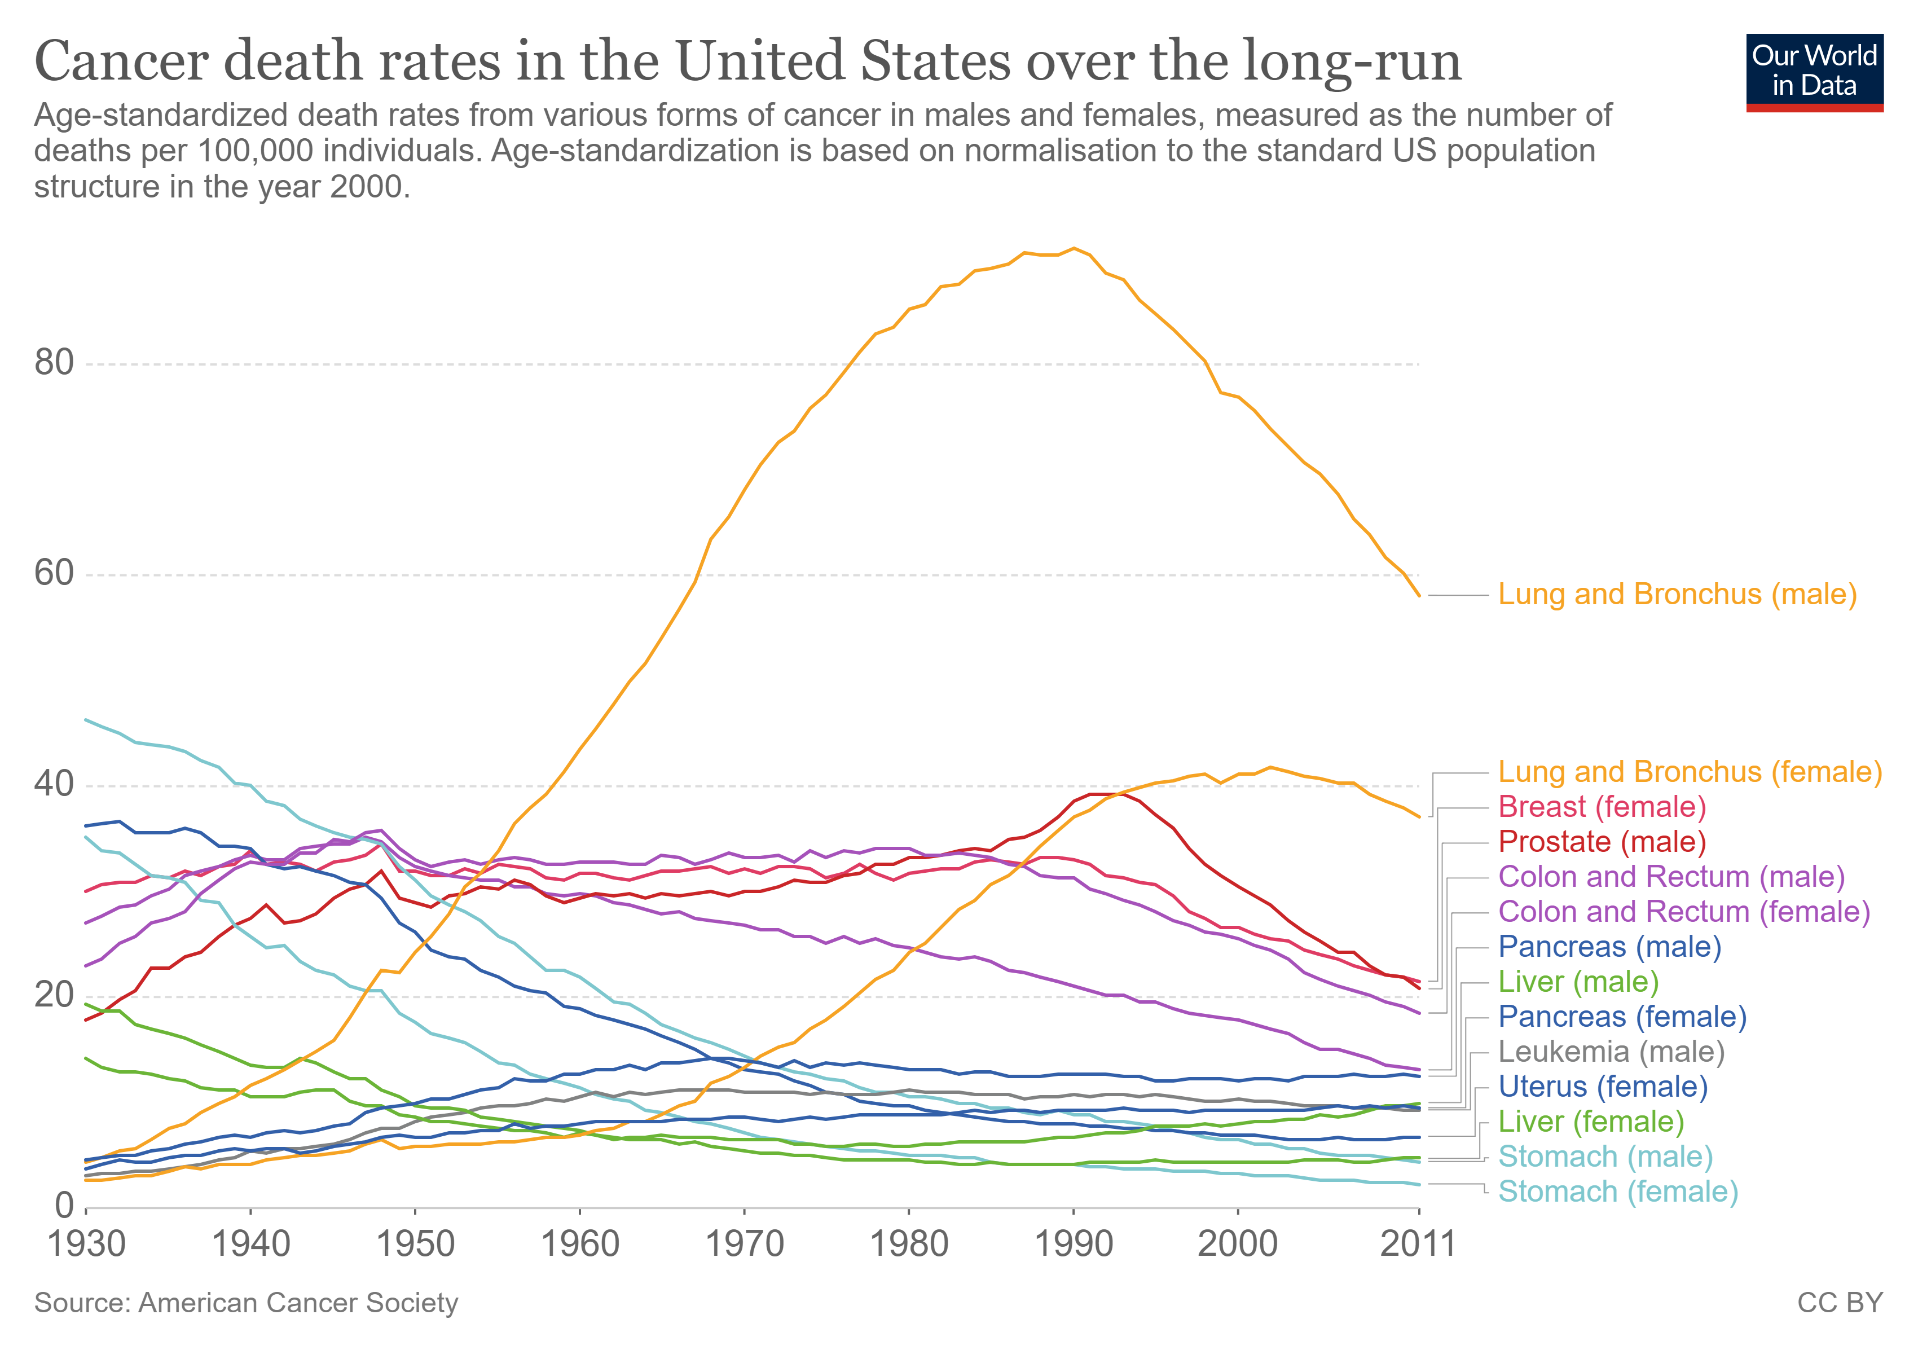
https://ourworldindata.org/cancer
Notes:
https://ourworldindata.org/cancer

Slide 31
1.3 Describing Distributions with Numbers
Measuring center: mean
Measuring center: median
Measuring spread: quartiles
Five-number summary and boxplot
Measuring spread: standard deviation
Choosing among summary statistics
Changing the unit of measurement

Slide 32
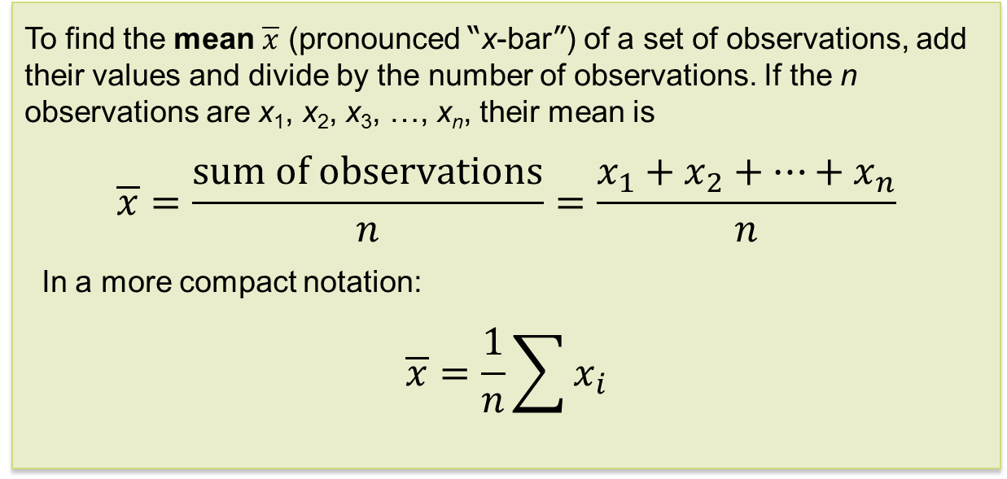
Measuring Center: The Mean
The most common measure of center is the arithmetic average, or mean.
To find the mean $\overline{x}$ (pronounced “x-bar”) of a set of observations, add their values and divide by the number of observations. If the n observations are x₁, x₂, x₃, …, x_{n}, their mean is
$$\overline{x}=\frac{\text{sum} \text{of} \text{observations}}{n}=\frac{x_{1}+x_{2}+…+x_{n}}{n}$$
In a more compact notation:
$$\overline{x}=\frac{1}{n}\sum{x_{i}}$$

Slide 33
Measuring Center: The Median
Because the mean cannot resist the influence of extreme observations, it is not a resistant or robust measure of center.
Another common measure of center is the median.
The median M is the midpoint of a distribution, the number such that half of the observations are smaller and the other half are larger.
To find the median of a distribution:
Arrange all observations from smallest to largest.
If the number of observations n is odd, the median M is the center observation in the ordered list.
If the number of observations n is even, the median M is the average of the two center observations in the ordered list.

Slide 34
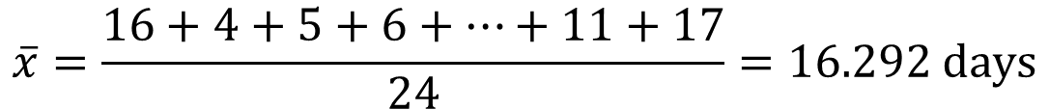
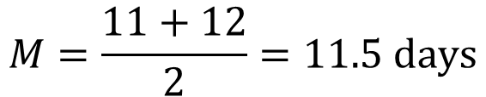
Measuring Center: Example
  Use the data below to calculate the mean and median of the time to start a business (in days) of 24 randomly selected countries.
16 | 4 | 5 | 6 | 5 | 7 | 12 | 19 | 10 | 2 | 25 | 19
38 | 5 | 24 | 8 | 6 | 5 | 53 | 32 | 13 | 49 | 11 | 17
$$\overline{x}=\frac{16+4+5+6+…+11+17}{24}=16.292 \text{days}$$
0 2455556678
1 01236799
2 45
3 28
4 9
5 3
Key: 4|9 represents a country that had a 49-day time to start a business.
$$M=\frac{11+12}{2}=11.5 \text{days}$$

Slide 35
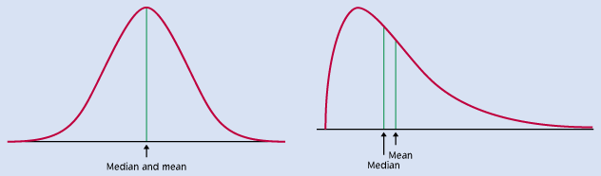
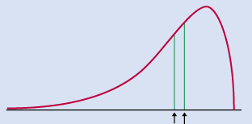
Comparing Mean and Median
The mean and median measure center in different ways, and both are useful.
The mean and median of a roughly symmetric distribution are close together.
If the distribution is exactly symmetric, the mean and median are exactly the same.
In a skewed distribution, the mean is usually farther out in the long tail than is the median.
Notes:
The areas of the halves from the median are equal.

Slide 36
Measuring Spread: The Quartiles
  A measure of center alone can be misleading.
  A useful numerical description of a distribution requires both a measure of center and a measure of spread.
Calculating the Quartiles
Arrange the observations in increasing order and locate the median M.
The first quartile Q₁ is the median of the observations located to the left of the median in the ordered list.
The third quartile Q₃ is the median of the observations located to the right of the median in the ordered list.

Slide 37
The Five-Number Summary
The minimum and maximum values alone tell us little about the distribution as a whole. Likewise, the median and quartiles tell us little about the tails of a distribution.
To get a quick summary of both center and spread, combine all five numbers.
The five-number summary of a distribution consists of the smallest observation, the first quartile, the median, the third quartile, and the largest observation, written in order from smallest to largest.
Minimum Q₁ M Q₃ Maximum

Slide 38
Boxplots 1
The median and quartiles divide the distribution roughly into quarters. This leads to a new way to display quantitative data, the boxplot.
How to Make a Boxplot
Draw and label a number line that includes the range of the distribution.
Draw a central box from Q₁ to Q₃.
Note the median M inside the box.
Extend lines (whiskers) from the box out to the minimum and maximum values that are not outliers (defined via the interquartile range (IQR)).

Slide 39


Suspected Outliers: 1.5 × IQR Rule
The interquartile range (IQR) is defined as IQR = Q₃ – Q₁.
In addition to serving as a measure of spread, the IQR is used as part of a rule of thumb for identifying outliers.
The 1.5 × IQR Rule for Outliers
Call an observation an outlier if it falls more than 1.5 × IQR above the third quartile or below the first quartile.
In the business start time data, Q₁ = 5.5 days, Q₃ = 21.5 days, and so IQR = 16 days.
For these data, 1.5 × IQR = 1.5(16) = 24
Q₁ – 1.5 × IQR = 5.5 – 24 = –18.5
Q₃+ 1.5 × IQR = 21.5 + 24 = 45.5
Any business start time shorter than –18.5 days or longer than 45.5 days is considered an outlier.
0 2455556678
1 01236799
2 45
3 28
4 9
5 3
Notes:
https://www.youtube.com/watch?v=XDS5TgZ4CJA

Slide 40
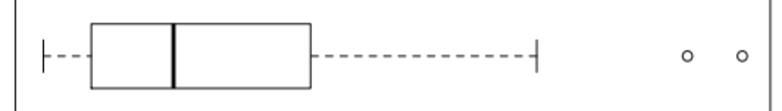
Boxplots 2
Consider our business start times data. Construct a boxplot.
16 | 4 | 5 | 6 | 5 | 7 | 12 | 19 | 10 | 2 | 25 | 19
38 | 5 | 24 | 8 | 6 | 5 | 53 | 32 | 13 | 49 | 11 | 17
Sort the data
2 | 4 | 5 | 5 | 5 | 5 | 6 | 6 | 7 | 8 | 10 | 11 | 12 | 13 | 16 | 17 | 19 | 19 | 24 | 25 | 32 | 38 | 49 | 53
This is an outlier by the
1.5 × IQR rule
Min = 2
Q₁ = 5.5
M = 11.5
Q₃= 21.5
Max = 53
This is an outlier by the
1.5 × IQR rule
Start Time

Slide 41
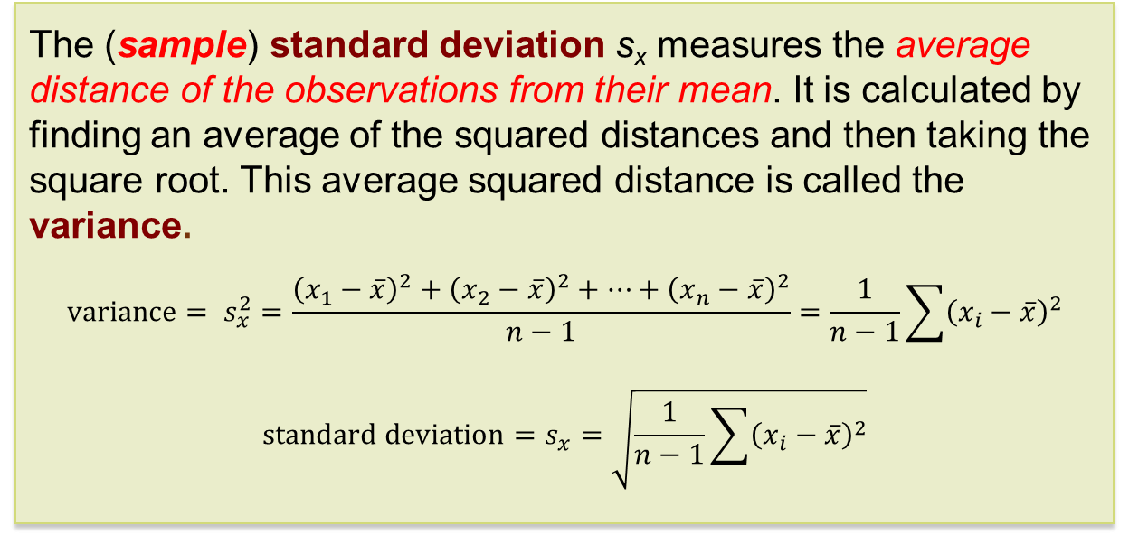
Measuring Spread:
The Standard Deviation
The most common measure of spread looks at how far each observation is from the mean. This measure is called the standard deviation.
The (sample) standard deviation s_{x} measures the average distance of the observations from their mean. It is calculated by finding an average of the squared distances and then taking the square root. This average squared distance is called the variance.
$$\text{variance}= s_{x}^{2}=\frac{{\left(x_{1}−\overline{x}\right)}^{2}+{\left(x_{2}−\overline{x}\right)}^{2}+…+{\left(x_{n}−\overline{x}\right)}^{2}}{n−1}=\frac{1}{n−1}\sum{{\left(x_{i}−\overline{x}\right)}^{2}}$$
$$\text{standard} \text{deviation}=s_{x}=\sqrt{\frac{1}{n−1}\sum{{\left(x_{i}−\overline{x}\right)}^{2}}}$$

Slide 42
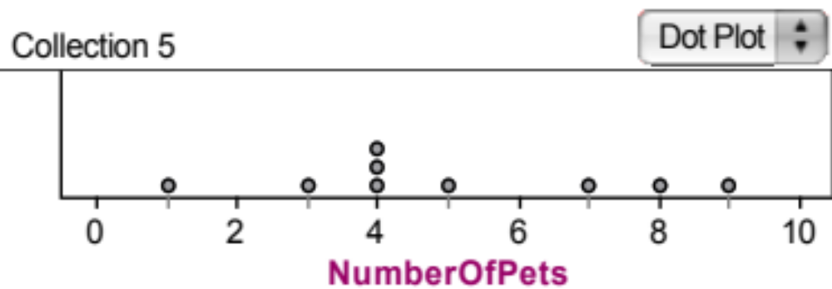

Calculating the Standard Deviation 1
Example: Consider the following data on the number of pets owned by a group of nine children.
Calculate the mean.
Calculate each deviation.
    deviation = observation – mean
deviation: 1 – 5 = -4
deviation: 8 – 5 = 3
Number of Pets
= 5

Slide 43
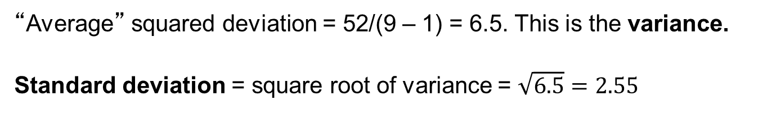
Calculating the Standard Deviation 2
x_{i} | (x_{i}-mean) | (x_{i}-mean)²
1 | 1 – 5 = –4 | (–4)² = 16
3 | 3 – 5 = –2 | (–2)² = 4
4 | 4 – 5 = –1 | (–1)² = 1
4 | 4 – 5 = –1 | (–1)² = 1
4 | 4 – 5 = –1 | (–1)² = 1
5 | 5 – 5 = 0 | (0)² = 0
7 | 7 – 5 = 2 | (2)² = 4
8 | 8 – 5 = 3 | (3)² = 9
9 | 9 – 5 = 4 | (4)² = 16
 | Sum = ? | Sum = ?
Square each deviation.
Find the “average” squared deviation. Calculate the sum of the squared deviations divided by (n – 1). This is called the variance.
Calculate the square root of the variance. This is the standard deviation.
“Average” squared deviation = 52/(9 – 1) = 6.5. This is the variance.
Standard deviation = square root of variance = $\sqrt{6.5}=2.55$

Slide 44
Properties of the Standard Deviation
s measures spread about the mean and should be used only when the mean is an appropriate measure of center.
s = 0 only when all observations have the same value and there is no spread. Otherwise, s > 0.
s is not resistant to outliers.
s has the same units of measurement as the original observations.

Slide 45
Choosing Measures of Center and Spread
We now have a choice between two descriptions for center and spread:
  Mean and standard deviation
  Median and interquartile range
Choosing Measures of Center and Spread
The median and IQR are usually better than the mean and standard deviation for describing a skewed distribution or a distribution with outliers.
Use mean and standard deviation only for reasonably symmetric distributions that do not have outliers.
NOTE: Numerical summaries do not fully describe the shape of a distribution. ALWAYS PLOT YOUR DATA! The numerical summaries and graphical displays complement one another.
Notes:
Give this example: (1) even the five numbers/boxplot are symmetric, the distributions may not be symmetric !! (very important)
for a multimodal distribution; compare boxplot, histogram, and 5 numbers
my_variable=c(rnorm(1000 , 0 , 2) , rnorm(1000 , 9 , 2))

Slide 46
Changing the Unit of Measurement
Variables can be recorded in different units of measurement. Most often, one measurement unit is a linear transformation of another measurement unit: x_{new} = a + bx.
Linear transformations do not change the basic shape of a distribution (skew, symmetry, multimodal). But they do change the measures of center and spread.
  Multiplying each observation by a positive number b multiplies both measures of center (mean, median) and spread (IQR, s) by b.
  Adding the same number a (positive or negative) to each observation adds a to measures of center and to quartiles, but it does not change measures of spread (IQR, s).
Notes:
Check data if there exist outliers (because of different unit of measurement for that outlier)

Slide 47
1.4 Density Curves and Normal Distributions
Density curves
Measuring center and spread for density curves
Normal distributions
The 68-95-99.7 rule
Standardizing observations
Using the standard normal table
Inverse normal calculations
Normal quantile plots

Slide 48
Exploring Quantitative Data
We now have a kit of graphical and numerical tools for describing distributions. We also have a strategy for exploring data on a single quantitative variable. Now we’ll add a fourth step to the strategy.
Exploring Quantitative Data
Always plot your data: make a graph.
Look for the overall pattern (shape, center, and spread) and for striking departures such as outliers.
Calculate a numerical summary to briefly describe center and spread.
Sometimes, the overall pattern of a large number of observations is so regular that we can describe it by a smooth curve.

Slide 49
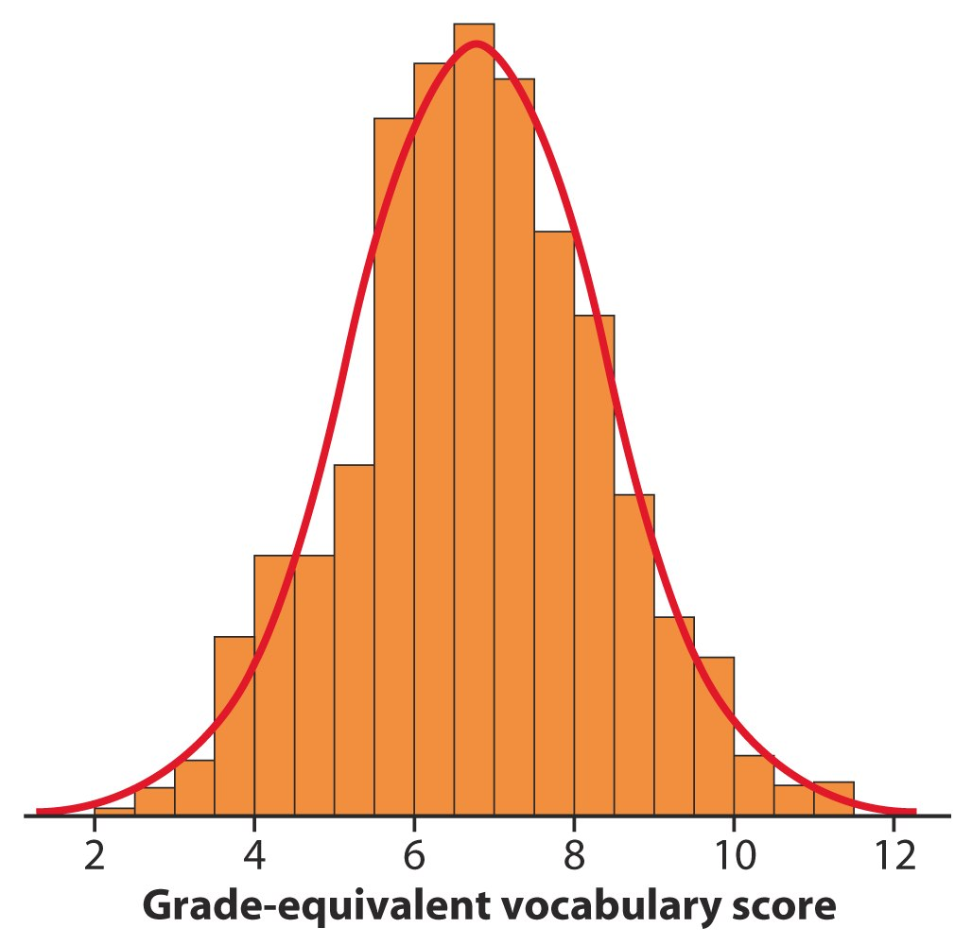
Density Curves 1
Example: Here is a histogram of vocabulary scores of 947 seventh graders.
The smooth curve drawn over the histogram is a mathematical model for the distribution.

Slide 50
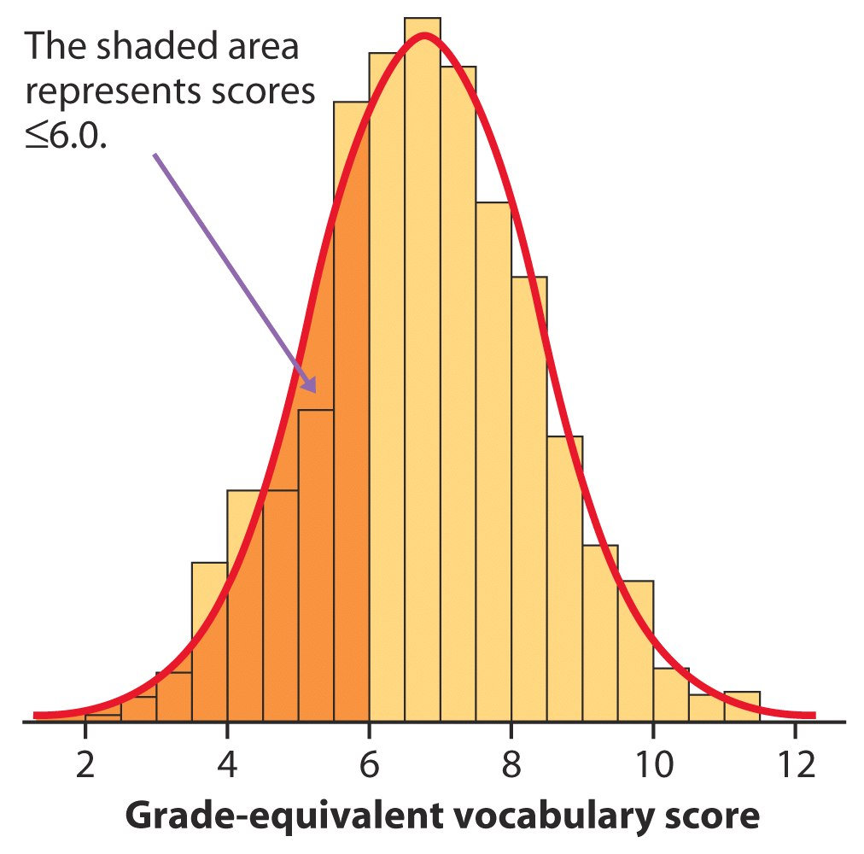
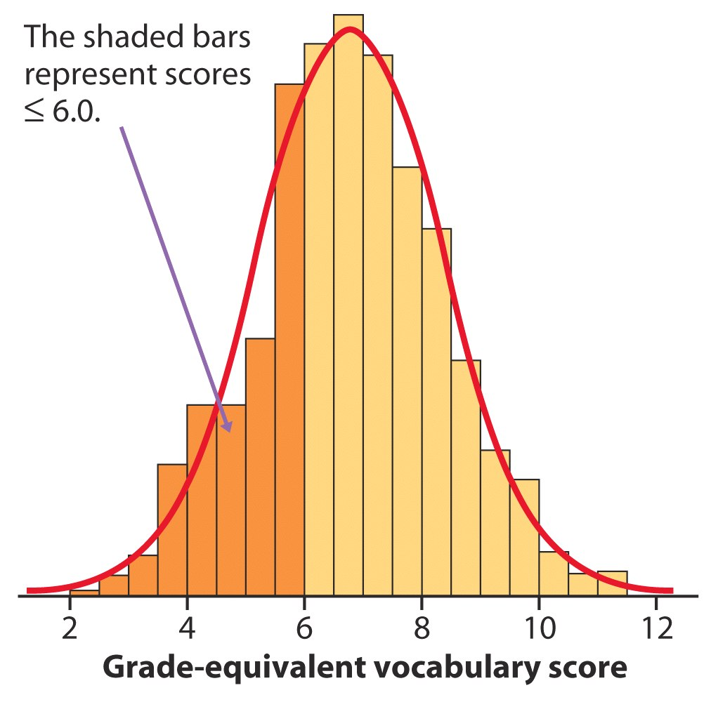
Density Curves 2
The areas of the shaded bars in this histogram represent the proportion of scores in the observed data that are less than or equal to 6.0. This proportion is equal to 0.303.
Now the area under the smooth curve to the left of 6.0 is shaded. If the scale is adjusted so the total area under the curve is exactly 1, then this curve is called a density curve. The proportion of the area to the left of 6.0 is now equal to 0.293.

Slide 51
Density Curves 3
A density curve is a curve that
  is always on or above the horizontal axis.
  has an area of exactly 1 underneath it.
A density curve describes the overall pattern of a distribution. The area under the curve and above any range of values on the horizontal axis is the proportion of all observations that fall in that range.

Slide 52
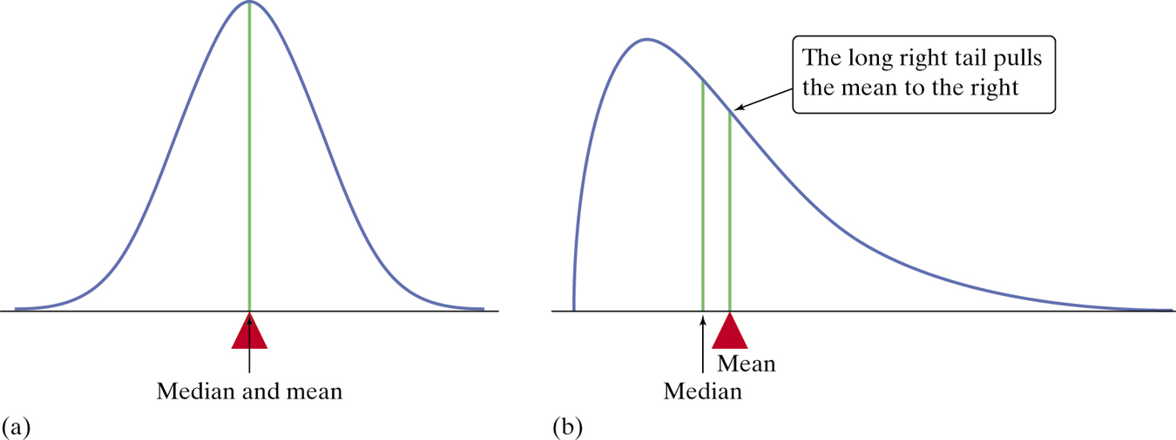
Density Curves 4
Our measures of center and spread apply to density curves as well as to actual sets of observations.
Distinguishing the Median and Mean of a Density Curve
The median of a density curve is the “equal-areas” point―the point that divides the area under the curve in half.
The mean of a density curve is the balance point, that is, the point at which the curve would balance if made of solid material.
The median and the mean are the same for a symmetric density curve. They both lie at the center of the curve. The mean of a skewed curve is pulled away from the median in the direction of the long tail.

Slide 53
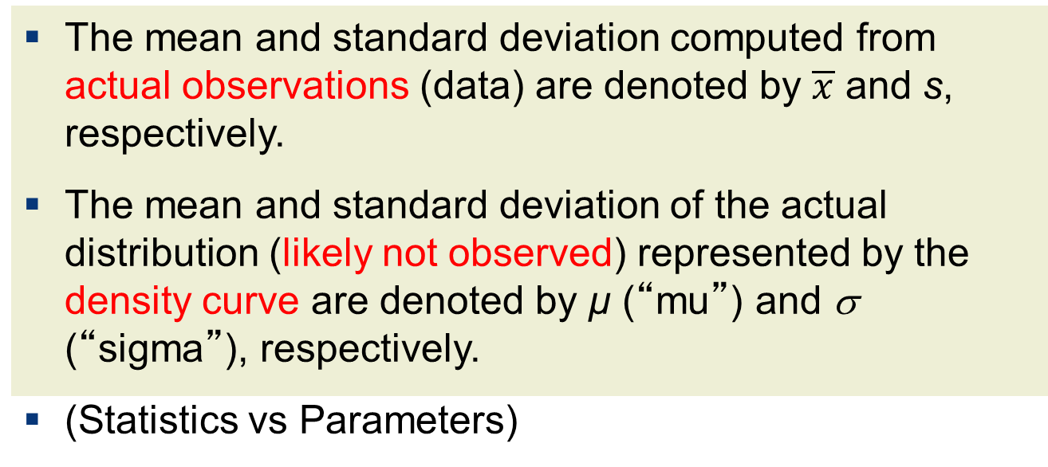
Density Curves 5
The mean and standard deviation computed from actual observations (data) are denoted by $\overline{x}$ and s, respectively.
The mean and standard deviation of the actual distribution (likely not observed) represented by the density curve are denoted by µ (“mu”) and σ (“sigma”), respectively.
(Statistics vs Parameters)

Slide 54
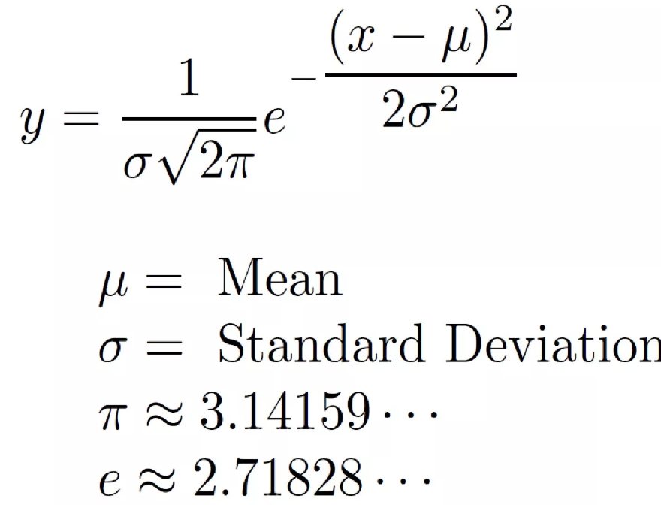
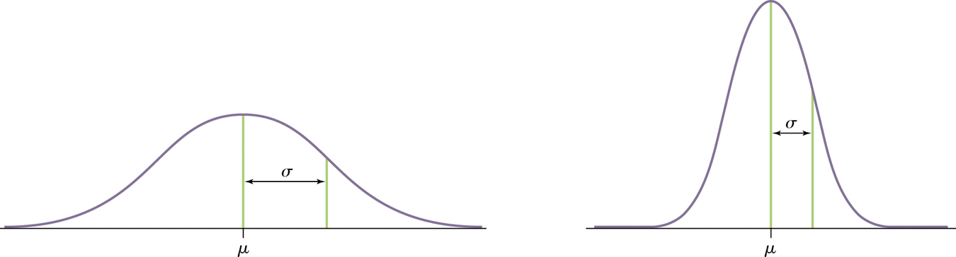
Normal Distributions 1
One particularly important class of density curves is the class of normal curves, which describe Normal distributions.
  All normal curves are symmetric, single-peaked, and bell-shaped.
  A specific normal curve is described by giving its mean µ and standard deviation σ.

Slide 55
Normal Distributions 2
A normal distribution is described by a normal density curve. Any particular normal distribution is completely specified by two numbers: its mean µ and standard deviation σ.
  The mean of a normal distribution is the center of the symmetric normal curve.
  The standard deviation is the distance from the center to the change-of-curvature points on either side.
  We abbreviate the normal distribution with mean µ and standard deviation σ as N(µ,σ).

Slide 56
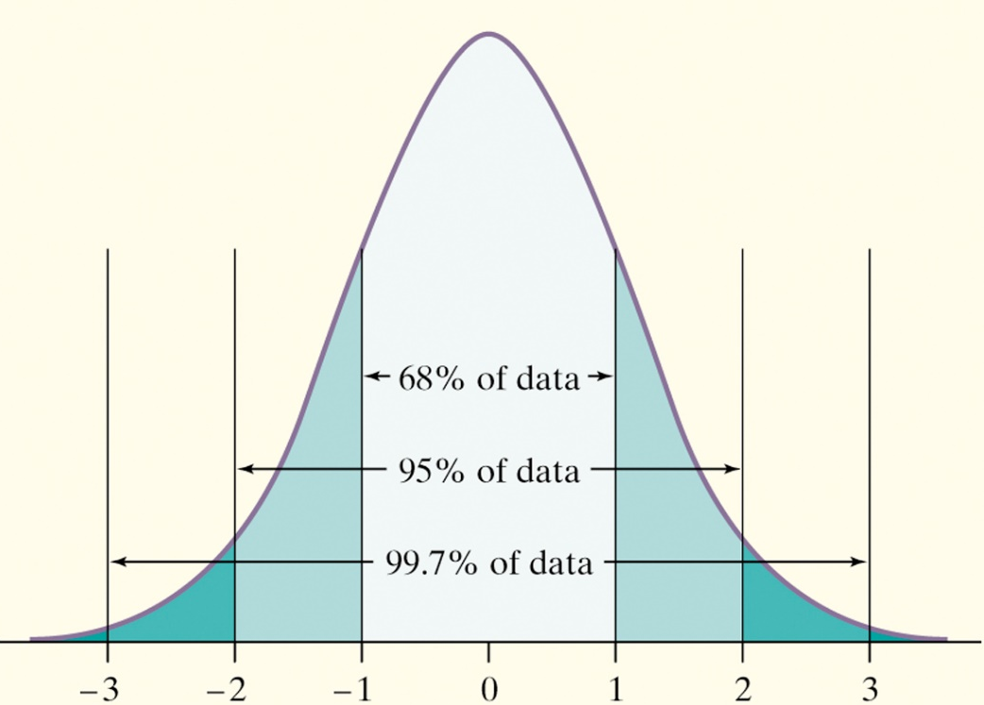
The 68-95-99.7 Rule 1
In the normal distribution with mean µ and standard deviation σ:
  approximately 68% of the observations fall within σ of µ.
  approximately 95% of the observations fall within 2σ of µ.
  approximately 99.7% of the observations fall within 3σ of µ.
Notes:
Statistical report mean +/- 2 SD
(pnorm(1)-0.5)*2 [1] 0.6826895
(pnorm(2)-0.5)*2 [1] 0.9544997
(pnorm(3)-0.5)*2 [1] 0.9973002

Slide 57
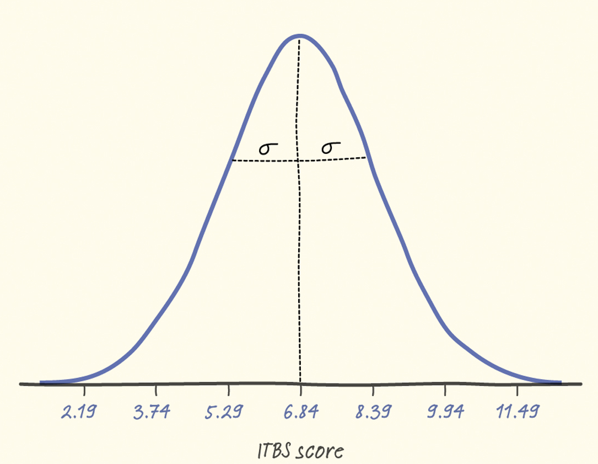
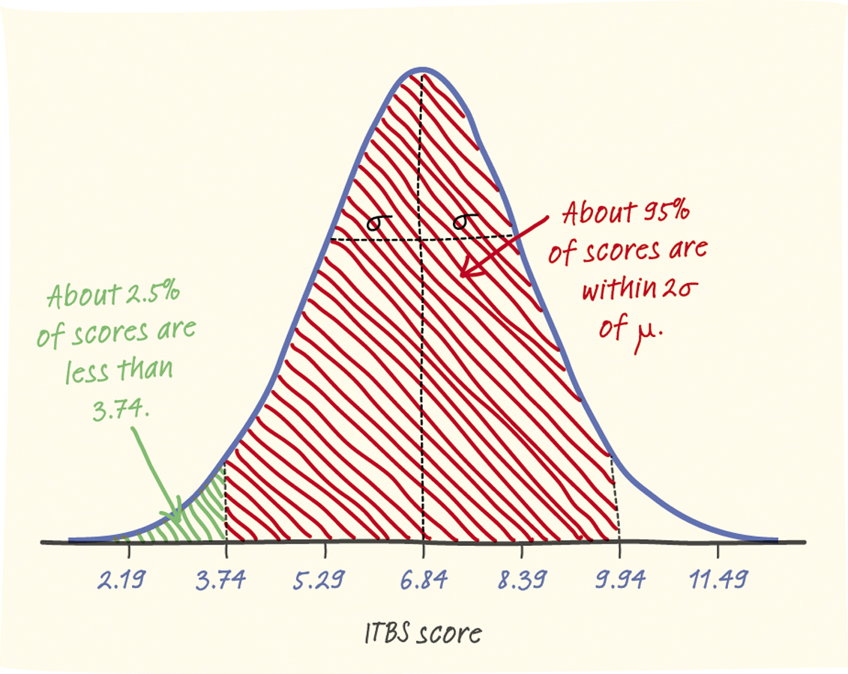
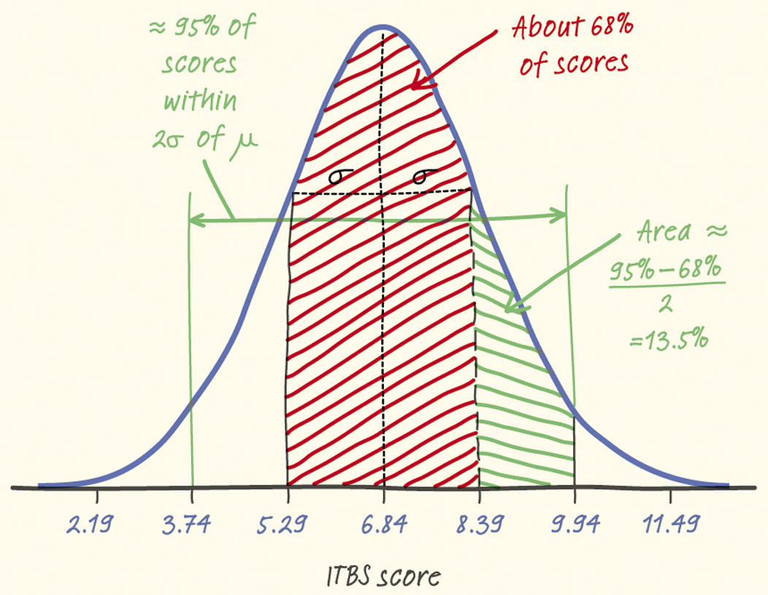
The 68-95-99.7 Rule 2
The distribution of Iowa Test of Basic Skills (ITBS) vocabulary scores for 7th grade students in Gary, Indiana, is close to normal. Suppose the distribution is N(6.84, 1.55).
Sketch the normal density curve for this distribution.
What percent of ITBS vocabulary scores is less than 3.74?
What percent of the scores is between 5.29 and 9.94?

Slide 58
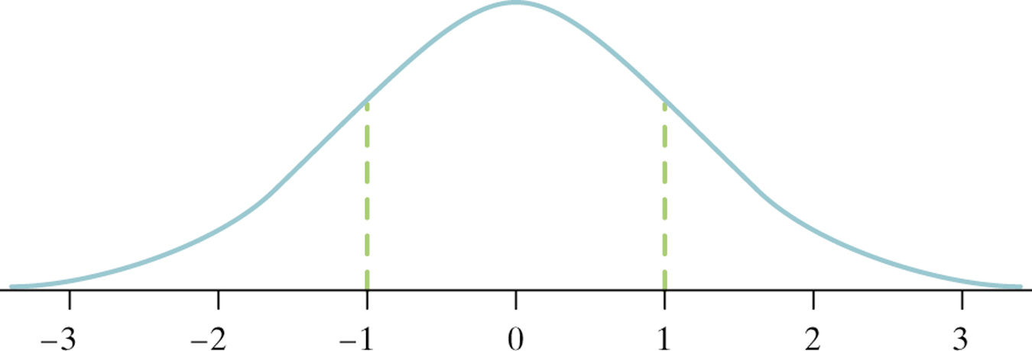
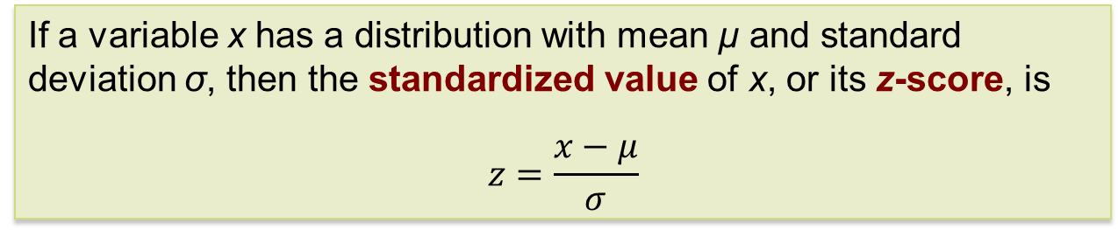
Standardizing Observations 2
If a variable x has a distribution with mean µ and standard deviation σ, then the standardized value of x, or its z-score, is
$$z=\frac{x−μ}{σ}$$
After standardization, all normal distributions can be expressed on the same scale (i.e., the standard normal distribution), with mean 0 and standard deviation 1.
The standard normal distribution is the normal distribution with mean 0 and standard deviation 1. That is, the standard normal distribution is N(0,1).
Notes:
This is transformation

Slide 59
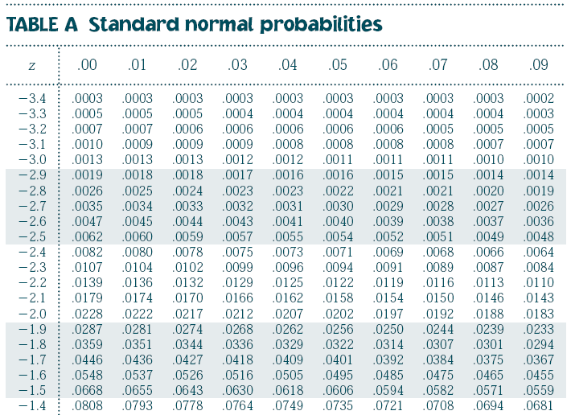
The Standard Normal Table 1
Because all normal distributions are the same when we standardize, we can find areas under any normal curve from a single table.
The Standard Normal Table
Table A is a table of areas under the standard normal curve. The table entry for each value z is the area under the curve to the left of z.
Notes:
Use function p norm: pnorm

Slide 60
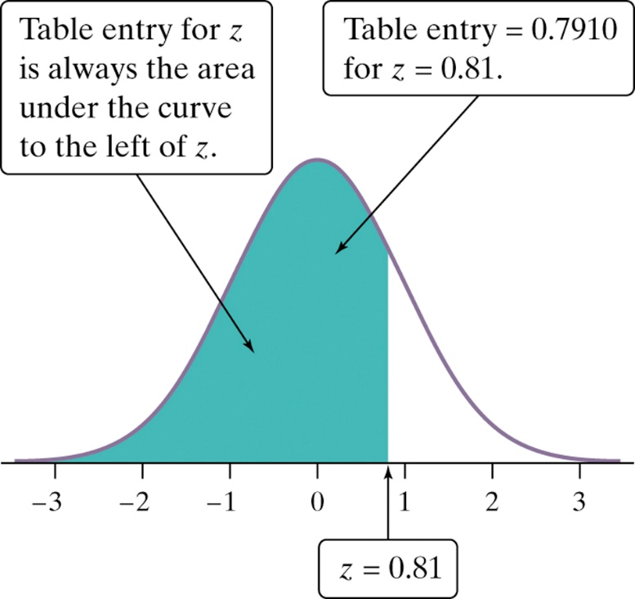
The Standard Normal Table 2
Suppose we want to find the proportion of observations from the standard normal distribution that are less than 0.81.
We can use Table A.
P(z < 0.81) =
.7910
Z | .00 | .01 | .02
0.7 | .7580 | .7611 | .7642
0.8 | .7881 | .7910 | .7939
0.9 | .8159 | .8186 | .8212

Slide 61
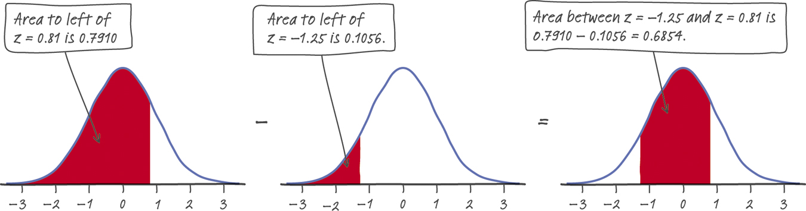
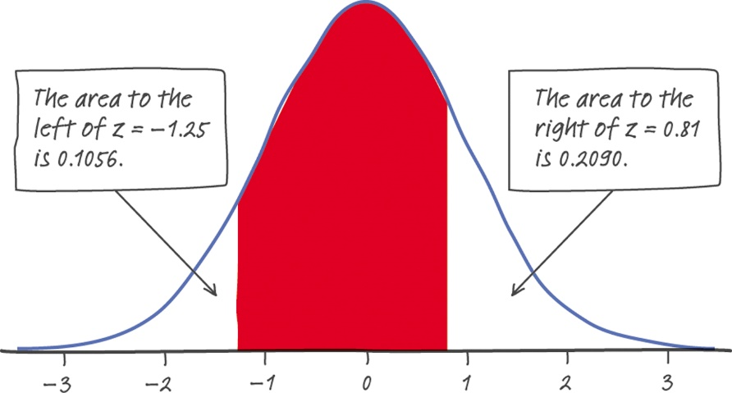
Normal Calculations 1
Find the proportion of observations from the standard normal distribution that are between –1.25 and 0.81.
Can you find the same proportion using a different approach?
1 – (0.1056+0.2090) = 1 – 0.3146
= 0.6854

Slide 62
Normal Calculations 2
How to Solve Problems Involving Normal Distributions
Express the problem in terms of the observed variable x.
Draw a picture of the distribution and shade the area of interest under the curve.
Perform calculations.
  Standardize x to restate the problem in terms of a standard Normal variable z.
  Use Table A and the fact that the total area under the curve is 1 to find the required area under the standard normal curve.
Write your conclusion in the context of the problem.
Notes:
May not need this slide

Slide 63
Normal Calculations 3
According to the National Health and Nutrition Examination Study (NHANES) of 1976–1980, the heights (in inches) of men aged 18–24 are N(70, 2.8).
If exactly 10% of men aged 18–24 are shorter than a particular
man, how tall is he?
N(70, 2.8)
.10
? 70
Notes:
What is the percentile of height for a man 6’1”?
What is the 95th percentile of height (qnorm(0.95)

Slide 64
Normal Calculations 4
If exactly 10% of men aged 18–24 are shorter than a particular
man, how tall is he?
N(70, 2.8)
.10
? 70
Look up the probability closest to 0.10 in the table.
Find the corresponding standardized score.
The value you seek is that many standard deviations from the mean.
z | .07 | .08 | .09
–1.3 | .0853 | .0838 | .0823
–1.2 | .1020 | .1003 | .0985
–1.1 | .1210 | .1190 | .1170
Z = –1.28

Slide 65
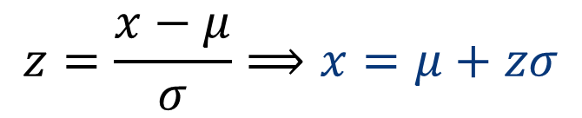
Normal Calculations 5
If exactly 10% of men aged 18–24 are shorter than a particular
man, how tall is he?
N(70, 2.8)
Z = –1.28
.10
? 70
We need to “unstandardize” the z-score to find the observed value (x):
$$z=\frac{x−μ}{σ}⟹x=μ+zσ$$
    x = 70 + z(2.8)
    = 70 + [(–1.28 ) × (2.8)]
    = 70 + (–3.58) = 66.42
A man would have to be approximately 66.42 inches tall or less to be in the lower 10% of all men in the population.

Slide 66
Normal Quantile Plots 1
One way to assess if a distribution is indeed approximately Normal is to plot the data on a normal quantile plot.
The data points are ranked and the percentile ranks are converted to z-scores with Table A. The z-scores are then used for the x axis against which the data are plotted on the y axis of the normal quantile plot.
  If the distribution is indeed normal, the plot will show a straight line, indicating a good match between the data and a normal distribution.
  Systematic deviations from a straight line indicate a non-normal distribution. Outliers appear as points that are far away from the overall pattern of the plot.
Notes:
qqnorm(x)

Slide 67
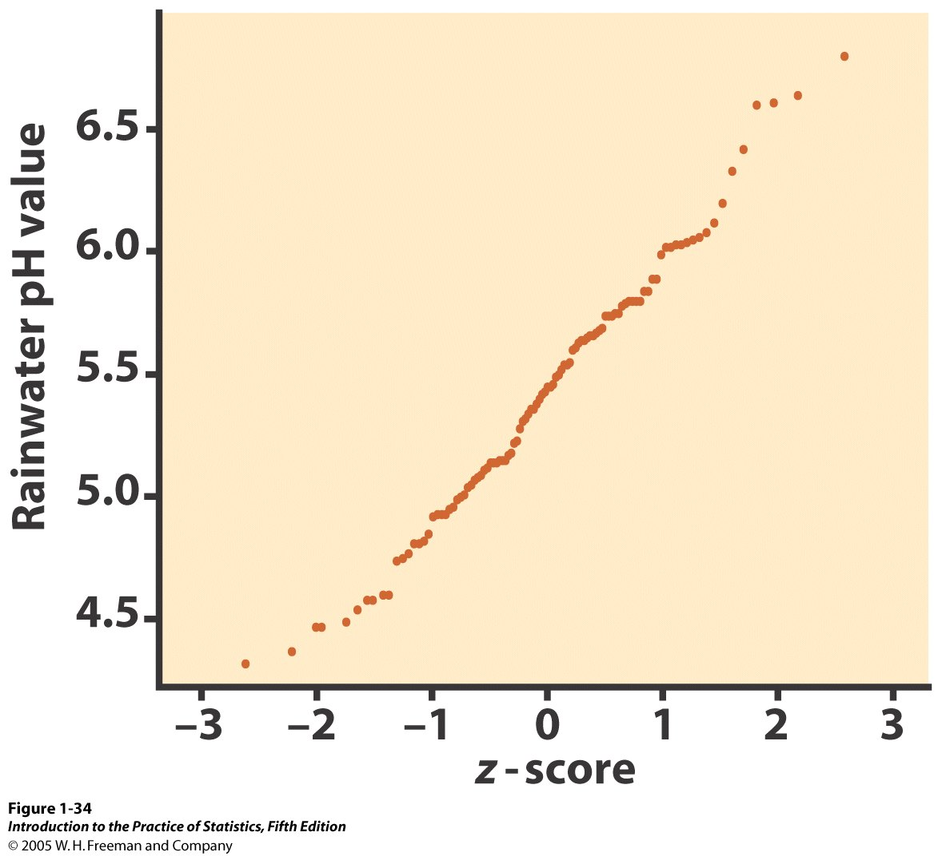
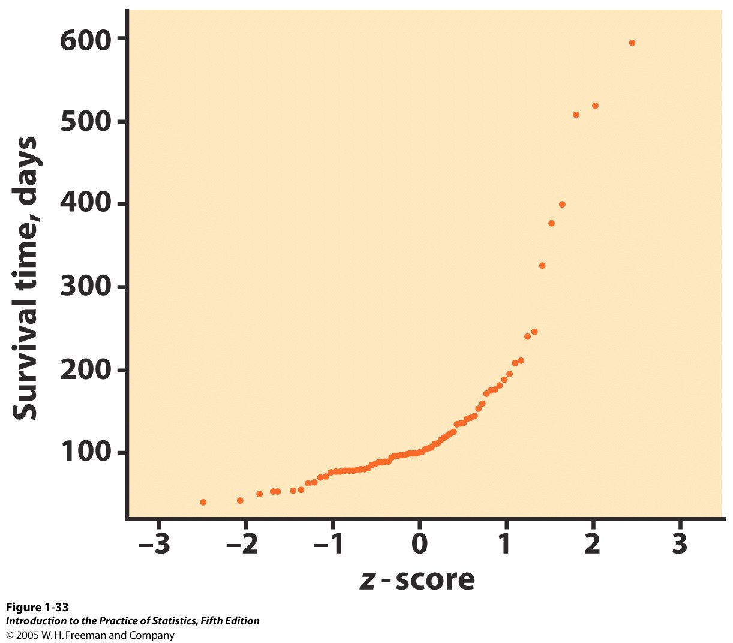
Normal Quantile Plots 2
Good fit to a straight line: The distribution of rainwater pH values is close to normal.
Curved pattern: The data are not normally distributed. Instead, the data are right skewed: A few individuals have particularly long survival times.
Normal quantile plots are complex to do by hand, but they are standard features in most statistical software.
Notes:
Compare with t distribution: x=rt(1000,2); qqnorm(x)

Slide 68
Chapter 1
Looking at Data—
Distributions (Review)
Introduction
1.1 Data
1.2 Displaying Distributions with Graphs
1.3 Describing Distributions with Numbers
1.4 Density Curves and Normal Distributions

